Slide 1
Data Mining and Warehousing
Week 6,7
Instructor : Mr. Natash Ali Mian
School of Computer and Information Technology
Beaconhouse National University

Slide 2

`
Switch off mobile phones during lectures, or put them into silent mode

Slide 3
Data Mining

Slide 4
Why Data Mining
Credit ratings/targeted marketing:
  Given a database of 100,000 names, which persons are the least likely to default on their credit cards?
  Identify likely responders to sales promotions
Fraud detection
  Which types of transactions are likely to be fraudulent, given the demographics and transactional history of a particular customer?
Customer relationship management:
  Which of my customers are likely to be the most loyal, and which are most likely to leave for a competitor? :
Data Mining helps extract such information

Slide 5
Why Data Mining?
The Explosive Growth of Data: from terabytes to petabytes
  Data collection and data availability
    Automated data collection tools, database systems, Web, computerized society
  Major sources of abundant data
    Business: Web, e-commerce, transactions, stocks, …
    Science: Remote sensing, bioinformatics, scientific simulation, …
    Society and everyone: news, digital cameras,
We are drowning in data, but starving for knowledge!
“Necessity is the mother of invention”—Data mining—Automated analysis of massive data sets

Slide 6
Evolution of Database Technology
1960s:
  Data collection, database creation, IMS and network DBMS
1970s:
  Relational data model, relational DBMS implementation
1980s:
  RDBMS, advanced data models (extended-relational, OO, deductive, etc.)
  Application-oriented DBMS (spatial, scientific, engineering, etc.)
1990s:
  Data mining, data warehousing, multimedia databases, and Web databases
2000s
  Stream data management and mining
  Data mining and its applications
  Web technology (XML, data integration) and global information systems

Slide 7
Data Mining Development
Similarity Measures
Hierarchical Clustering
Imprecise Queries
Textual Data
Web Search Engines
Relational Data Model
SQL
Association Rule Algorithms
Data Warehousing
Scalability Techniques
Bayes Theorem
Regression Analysis
K-Means Clustering
Time Series Analysis
DATA MINING
Algorithm Design Techniques
Algorithm Analysis
Data Structures
Neural Networks
Decision Tree Algorithms
HIGH PERFORMANCE
© Prentice Hall

Slide 8
Data mining
Process of analyzing large databases to find patterns that are:
  valid: hold on new data with some certainty
  novel: non-obvious to the system
  useful: should be possible to act on the item
  understandable: humans should be able to interpret the pattern
Also known as Knowledge Discovery in Databases (KDD)

Slide 9
The Data Mining Process
1. Understand the domain
2. Create a dataset:
  Select the interesting attributes
  Data cleaning and preprocessing
3. Choose the data mining task and the specific algorithm
4. Interpret the results, and possibly return to 2

Slide 10
Data Mining Tasks
1. Classification: learning a function that maps an item into one of a set of predefined classes
2. Regression: learning a function that maps an item to a real value
3. Clustering: identify a set of groups of similar items

Slide 11
Data Mining Tasks
4. Dependencies and associations:
identify significant dependencies between data attributes
5. Summarization: find a compact description of the dataset or a subset of the dataset

Slide 12
Data Mining Methods
1. Decision Tree Classifiers:
  Used for modeling, classification
2. Association Rules:
  Used to find associations between sets of attributes
3. Sequential patterns:
  Used to find temporal associations in time series
4. Hierarchical clustering:
used to group customers, web users, etc

Slide 13
Examples: What is (not) Data Mining?
What is not Data Mining?
  Look up phone number in phone directory
  Query a Web search engine for information about “Amazon”
What is Data Mining?
  Certain names are more prevalent in certain US locations (O’Brien, O’Rurke, O’Reilly… in Boston area)
  Group together similar documents returned by search engine according to their context (e.g. Amazon rainforest, Amazon.com,)

Slide 14
Why Data Preprocessing?
Data in the real world is dirty
  incomplete: lacking attribute values, lacking certain attributes of interest, or containing only aggregate data
  noisy: containing errors or outliers
  inconsistent: containing discrepancies in codes or names
No quality data, no quality mining results!
  Quality decisions must be based on quality data
  Data warehouse needs consistent integration of quality data
  Required for both OLAP and Data Mining!

Slide 15
Why can Data be Incomplete?
Attributes of interest are not available (e.g., customer information for sales transaction data)
Data were not considered important at the time of transactions, so they were not recorded!
Data not recorded because of misunderstanding or malfunctions
Data may have been recorded and later deleted!
Missing/unknown values for some data

Slide 16
Data Cleaning
Data cleaning tasks
  Fill in missing values
  Identify outliers and smooth out noisy data
  Correct inconsistent data

Slide 17
Applications
Banking: loan/credit card approval
  predict good customers based on old customers
Customer relationship management:
  identify those who are likely to leave for a competitor.
Targeted marketing:
  identify likely responders to promotions
Fraud detection: telecommunications, financial transactions
  from an online stream of event identify fraudulent events
Manufacturing and production:
  automatically adjust knobs when process parameter changes
Notes:
Any area where large amounts of historic data that if understood
better can help shape future decisions.

Slide 18
Applications (continued)
Medicine: disease outcome, effectiveness of treatments
  analyze patient disease history: find relationship between diseases
Molecular/Pharmaceutical: identify new drugs
Scientific data analysis:
  identify new galaxies by searching for sub clusters
Web site/store design and promotion:
  find affinity of visitor to pages and modify layout

Slide 19
Examples of Large Datasets
Government: IRS, NGA, …
Large corporations
  WALMART: 20M transactions per day
  MOBIL: 100 TB geological databases
  AT&T 300 M calls per day
  Credit card companies
Scientific
  NASA, EOS project: 50 GB per hour
  Environmental datasets

Slide 20
Market Analysis and Management
Where does the data come from?
  Credit card transactions, discount coupons, customer complaint calls
Target marketing
  Find clusters of “model” customers who share the same characteristics: interest, income level, spending habits, etc.
  Determine customer purchasing patterns over time

Slide 21
Market Analysis and Management
Cross-market analysis
  Associations/co-relations between product sales, & prediction based on such association
Customer profiling
  What types of customers buy what products
Customer requirement analysis
  Identifying the best products for different customers
  Predict what factors will attract new customers

Slide 22
Fraud Detection & Mining Unusual Patterns
Approaches: Clustering & model construction for frauds, outlier analysis
Applications: Health care, retail, credit card service, telecomm.
  Medical insurance
    Professional patients, and ring of doctors
    Unnecessary or correlated screening tests
  Telecommunications:
    Phone call model: destination of the call, duration, time of day or week. Analyze patterns that deviate from an expected norm
  Retail industry
    Analysts estimate that 38% of retail shrink is due to dishonest employees

Slide 23
Other Applications
Internet Web Surf-Aid
  IBM Surf-Aid applies data mining algorithms to Web access logs for market-related pages to discover customer preference and behavior pages, analyzing effectiveness of Web marketing, improving Web site organization, etc.

Slide 24
Data Mining: A KDD Process
Knowledge
  Data mining—core of knowledge discovery process
Pattern Evaluation
Data Mining
Task-relevant Data
Data Warehouse
Selection
Data Cleaning
Data Integration
Databases

Slide 25
KDD Process
Selection:
  Select log data (dates and locations) to use
Preprocessing:
  Remove identifying URLs
  Remove error logs
Transformation:
  Sort and Group)
Data Mining:
  Identify and count patterns
  Construct data structure
Interpretation/Evaluation:
  Identify and display frequently accessed sequences.
Potential User Applications:
  Personalization
© Prentice Hall

Slide 26
Steps of a KDD Process
Learning the application domain
  Relevant prior knowledge and goals of application
Creating a target data set: data selection
Data cleaning and preprocessing: (may take 60% of effort!)
Data reduction and transformation
  Find useful features, dimensionality/variable reduction.
Choosing functions of data mining
  Summarization, classification, regression, association, clustering.
Choosing the mining algorithm(s)
Data mining: search for patterns of interest
Pattern evaluation and knowledge presentation
  Visualization, transformation, removing redundant patterns, etc.
Use of discovered knowledge

Slide 27
The KDD process (Summarized)
Problem fomulation
Data collection
  subset data: sampling might hurt if highly skewed data
  feature selection: principal component analysis, heuristic search
Pre-processing: cleaning
  name/address cleaning, different meanings (annual, yearly), duplicate removal, supplying missing values
Transformation:
  map complex objects e.g. time series data to features e.g. frequency
Choosing mining task and mining method:
Result evaluation and Visualization:
Knowledge discovery is an iterative process

Slide 28
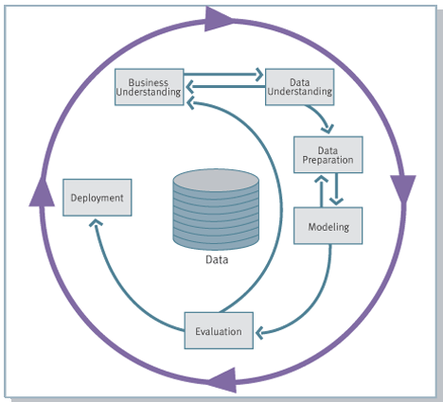
Knowledge Discovery Process
flow, according to CRISP-DM
Business Understanding + Data Understanding + Data Preparation 80% of the time
Modeling (applying mining algorithm) 20%
Monitoring

Slide 29
KDD Issues
Human Interaction
Overfitting
Outliers
Interpretation
Visualization
Large Datasets
High Dimensionality
© Prentice Hall

Slide 30
KDD Issues (cont’d)
Multimedia Data
Missing Data
Irrelevant Data
Noisy Data
Changing Data
Integration
Application
© Prentice Hall

Slide 31
Phases and Tasks
Business
Understanding
Data
Understanding
Data
Preparation
Modeling
Evaluation
Deployment
Determine
Business Objectives
Background
Business Objectives
Business Success
Criteria
Situation Assessment
Inventory of Resources
Requirements,
Assumptions, and
Constraints
Risks and Contingencies
Terminology
Costs and Benefits
Determine
Data Mining Goal
Data Mining Goals
Data Mining Success
Criteria
Produce Project Plan
Project Plan
Initial Asessment of
Tools and Techniques
Collect Initial Data
Initial Data Collection
Report
Describe Data
Data Description Report
Explore Data
Data Exploration Report
Verify Data Quality
Data Quality Report
Data Set
Data Set Description
Select Data
Rationale for Inclusion /
Exclusion
Clean Data
Data Cleaning Report
Construct Data
Derived Attributes
Generated Records
Integrate Data
Merged Data
Format Data
Reformatted Data
Select Modeling
Technique
Modeling Technique
Modeling Assumptions
Generate Test Design
Test Design
Build Model
Parameter Settings
Models
Model Description
Assess Model
Model Assessment
Revised Parameter
Settings
Evaluate Results
Assessment of Data
Mining Results w.r.t.
Business Success
Criteria
Approved Models
Review Process
Review of Process
Determine Next Steps
List of Possible Actions
Decision
Plan Deployment
Deployment Plan
Plan Monitoring and
Maintenance
Monitoring and
Maintenance Plan
Produce Final Report
Final Report
Final Presentation
Review Project
Experience
Documentation

Slide 32
Architecture: Typical Data Mining System
Graphical user interface
Pattern evaluation
Data mining engine
Knowledge-base
Database or data warehouse server
Data cleaning & data integration
Filtering
Data
Warehouse
Databases

Slide 33
Data Mining: On What Kinds of Data?
Relational database
Data warehouse
Transactional database
Advanced database and information repository
  Spatial and temporal data
  Time-series data
  Stream data
  Multimedia database
  Text databases & WWW

Slide 34
Data Mining Functionalities
Cluster analysis
  Class label is unknown: Group data to form new classes, e.g., cluster houses to find distribution patterns
  Maximizing intra-class similarity & minimizing interclass similarity
Outlier analysis
  Outlier: a data object that does not comply with the general behavior of the data
  Useful in fraud detection, rare events analysis
Trend and evolution analysis
  Trend and deviation: regression analysis
  Sequential pattern mining, periodicity analysis

Slide 35
Are All the “Discovered” Patterns Interesting?
Data mining may generate thousands of patterns: Not all of them are interesting
  Suggested approach: Human-centered, query-based, focused mining
Interestingness measures
  A pattern is interesting if it is easily understood by humans, valid on new or test data with some degree of certainty, potentially useful, novel, or validates some hypothesis that a user seeks to confirm
Objective vs. subjective interestingness measures
  Objective: based on statistics and structures of patterns, e.g., support, confidence, etc.
  Subjective: based on user’s belief in the data, e.g., unexpectedness, novelty.

Slide 36
Data Mining: Confluence of Multiple Disciplines
Database
Systems
Statistics
Machine
Learning
Data Mining
Visualization
Algorithm
Other
Disciplines

Slide 37
Related Fields
Machine
Learning
Visualization
Data Mining and
Knowledge Discovery
Statistics
Databases

Slide 38
Relationship with other fields
Overlaps with machine learning, statistics, artificial intelligence, databases, visualization but more stress on
  scalability of number of features and instances
  stress on algorithms and architectures whereas foundations of methods and formulations provided by statistics and machine learning.
  automation for handling large, heterogeneous data

Slide 39
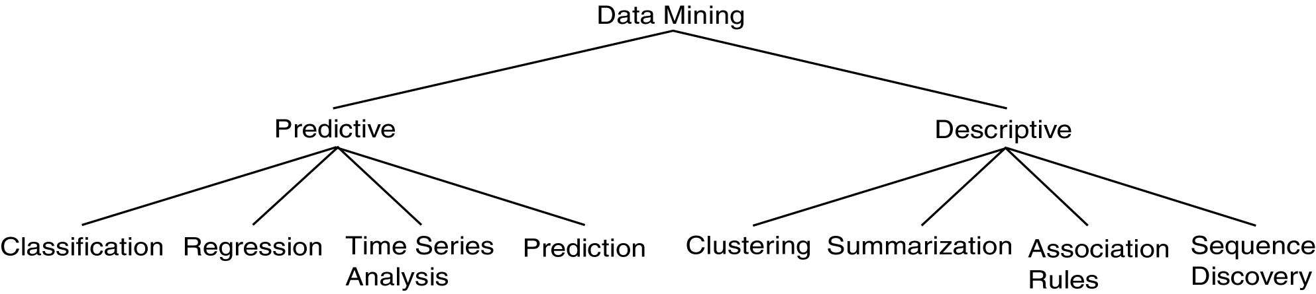
Data Mining Models and Tasks

Slide 40
Some basic operations
Predictive:
  Regression
  Classification
  Collaborative Filtering
Descriptive:
  Clustering / similarity matching
  Association rules and variants
  Deviation detection
Notes:
Each topic is a talk..

Slide 41
Major Issues in Data Mining
Mining methodology
  Mining different kinds of knowledge from diverse data types, e.g., bio, stream, Web
  Performance: efficiency, effectiveness, and scalability
  Pattern evaluation: the interestingness problem
  Incorporation of background knowledge
  Handling noise and incomplete data
  Parallel, distributed and incremental mining methods
  Integration of the discovered knowledge with existing one: knowledge fusion

Slide 42
Major Issues in Data Mining
User interaction
  Data mining query languages and ad-hoc mining
  Expression and visualization of data mining results
  Interactive mining of knowledge at multiple levels of abstraction
Applications and social impacts
  Domain-specific data mining & invisible data mining
  Protection of data security, integrity, and privacy

Slide 43
Classification

Slide 44
Classification: Definition
Given a collection of records (training set )
  Each record contains a set of attributes, one of the attributes is the class.
Find a model for class attribute as a function of the values of other attributes.
Goal: previously unseen records should be assigned a class as accurately as possible.
  A test set is used to determine the accuracy of the model. Usually, the given data set is divided into training and test sets, with training set used to build the model and test set used to validate it.

Slide 45
An Example
Classification
(from Pattern Classification by Duda & Hart & Stork – Second Edition, 2001)
A fish-packing plant wants to automate the process of sorting incoming fish according to species
As a pilot project, it is decided to try to separate sea bass from salmon using optical sensing

Slide 46
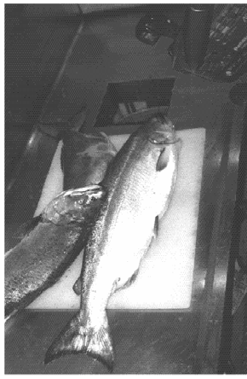
An Example (continued)
Classification
Features (to distinguish):
Length
Lightness
Width
Position of mouth

Slide 47
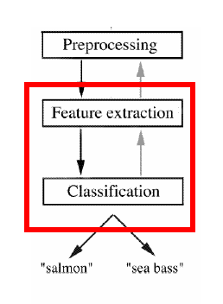
An Example (continued)
Classification
Preprocessing: Images of different fishes are isolated from one another and from background;
Feature extraction: The information of a single fish is then sent to a feature extractor, that measure certain “features” or “properties”;
Classification: The values of these features are passed to a classifier that evaluates the evidence presented, and build a model to discriminate between the two species

Slide 48
An Example (continued)
Classification
Domain knowledge:
  A sea bass is generally longer than a salmon
Related feature: (or attribute)
  Length
Training the classifier:
  Some examples are provided to the classifier in this form: <fish_length, fish_name>
  These examples are called training examples
  The classifier learns itself from the training examples, how to distinguish Salmon from Bass based on the fish_length

Slide 49
An Example (continued)
Classification
Classification model (hypothesis):
  The classifier generates a model from the training data to classify future examples (test examples)
  An example of the model is a rule like this:
  If Length >= l* then sea bass otherwise salmon
  Here the value of l* determined by the classifier
Testing the model
  Once we get a model out of the classifier, we may use the classifier to test future examples
  The test data is provided in the form <fish_length>
  The classifier outputs <fish_type> by checking fish_length against the model

Slide 50
An Example (continued)
Classification
So the overall classification process goes like this →
Training Data
Test/Unlabeled Data
Preprocessing, and feature extraction
Preprocessing, and feature extraction
Feature vector
Feature vector
Training
Testing against model/
Classification
Model
Prediction/Evaluation

Slide 51
An Example (continued)
Classification
Pre-processing, Feature extraction
If len > 12, then sea bass else salmon
12, salmon
15, sea bass
8, salmon
5, sea bass
Training
Training data
Model
Feature vector
Labeled data
Pre-processing, Feature extraction
sea bass (error!)
salmon (correct)
sea bass
salmon
15, salmon
10, salmon
18, ?
8, ?
Test/
Classify
Test data
Feature vector
Evaluation/Prediction
Unlabeled data

Slide 52
An Example (continued)
Classification
Why error?
  Insufficient training data
  Too few features
  Too many/irrelevant features
  Overfitting / specialization

Slide 53
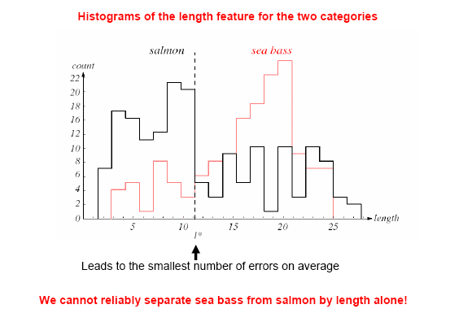
An Example (continued)
Classification

Slide 54
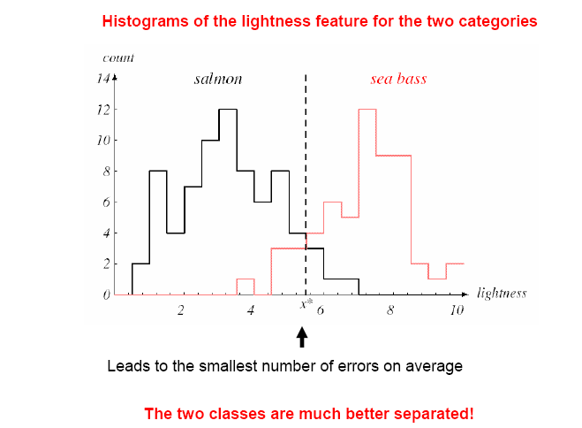
An Example (continued)
Classification
New Feature:
  Average lightness of the fish scales

Slide 55
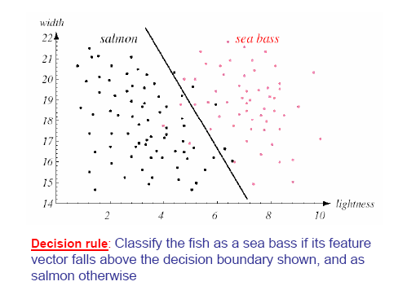
An Example (continued)
Classification

Slide 56
An Example (continued)
Classification
Pre-processing, Feature extraction
If ltns > 6 or
len*5+ltns*2>100 then sea bass else salmon
12, 4, salmon
15, 8, sea bass
8, 2, salmon
5, 10, sea bass
Training
Training data
Model
Feature vector
Pre-processing, Feature extraction
salmon (correct)
salmon (correct)
sea bass
salmon
15, 2, salmon
10, 7, salmon
18, 7, ?
8, 5, ?
Test/
Classify
Test data
Feature vector
Evaluation/Prediction

Slide 57
Terms
Classification
  Accuracy:
    % of test data correctly classified
    In our first example, accuracy was 3 out 4 = 75%
    In our second example, accuracy was 4 out 4 = 100%
  False positive:
    Negative class incorrectly classified as positive
    Usually, the larger class is the negative class
    Suppose
      salmon is negative class
      sea bass is positive class

Slide 58
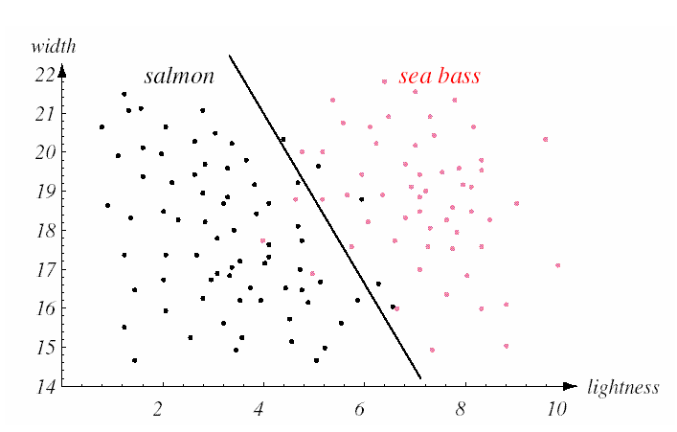
Terms
Classification
false positive
false negative

Slide 59
Classification: Application 1
Direct Marketing
  Goal: Reduce cost of mailing by targeting a set of consumers likely to buy a new cell-phone product.
  Approach:
    Use the data for a similar product introduced before.
    We know which customers decided to buy and which decided otherwise. This {buy, don’t buy} decision forms the class attribute.
    Collect various demographic, lifestyle, and company-interaction related information about all such customers.
      Type of business, where they stay, how much they earn, etc.
    Use this information as input attributes to learn a classifier model.

Slide 60
Classification: Application 2
Fraud Detection
  Goal: Predict fraudulent cases in credit card transactions.
  Approach:
    Use credit card transactions and the information on its account-holder as attributes.
      When does a customer buy, what does he buy, how often he pays on time, etc
    Label past transactions as fraud or fair transactions. This forms the class attribute.
    Learn a model for the class of the transactions.
    Use this model to detect fraud by observing credit card transactions on an account.

Slide 61
Classification: Application 3
Customer Attrition/Churn:
  Goal: To predict whether a customer is likely to be lost to a competitor.
  Approach:
    Use detailed record of transactions with each of the past and present customers, to find attributes.
      How often the customer calls, where he calls, what time-of-the day he calls most, his financial status, marital status, etc.
    Label the customers as loyal or disloyal.
    Find a model for loyalty.

Slide 62
Classification: Application 4
Sky Survey Cataloging
  Goal: To predict class (star or galaxy) of sky objects, especially visually faint ones, based on the telescopic survey images (from Palomar Observatory).
      3000 images with 23,040 x 23,040 pixels per image.
  Approach:
    Segment the image.
    Measure image attributes (features) - 40 of them per object.
    Model the class based on these features.
    Success Story: Could find 16 new high red-shift quasars, some of the farthest objects that are difficult to find!

Slide 63



Classifying Galaxies
Early
Class:
Stages of Formation
Attributes:
Image features,
Characteristics of light waves received, etc.
Intermediate
Late
Data Size:
72 million stars, 20 million galaxies
Object Catalog: 9 GB
Image Database: 150 GB

Slide 64
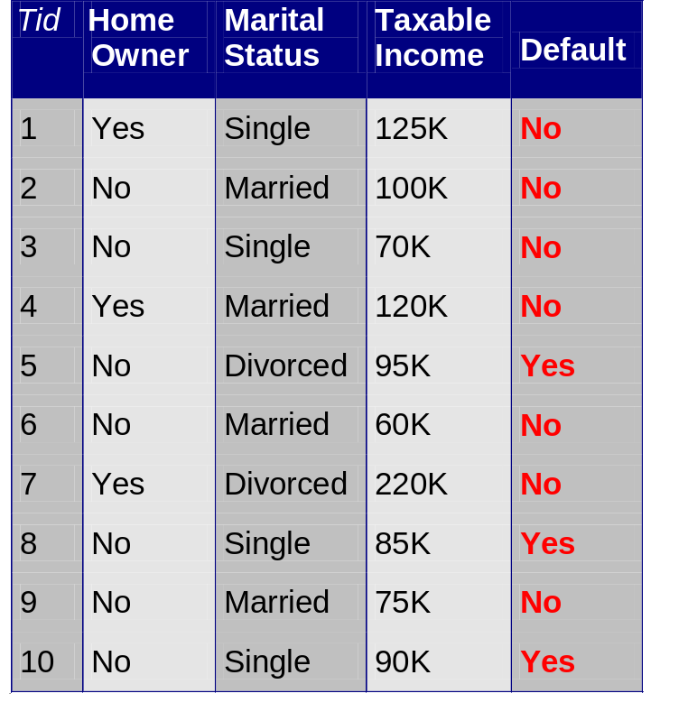
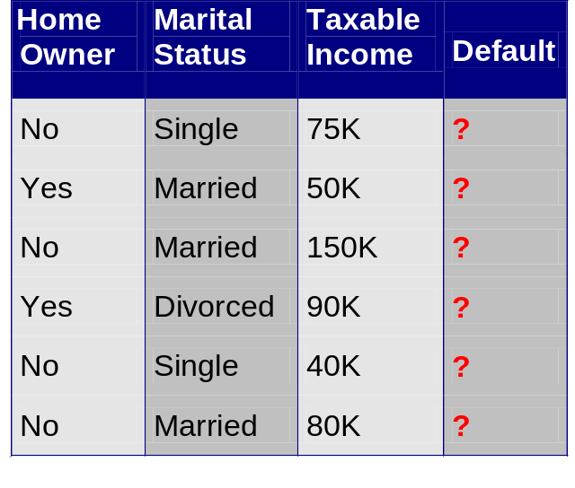
Classification Example
categorical
categorical
continuous
class
Test
Set
Learn
Classifier
Training
Set
Model

Slide 65
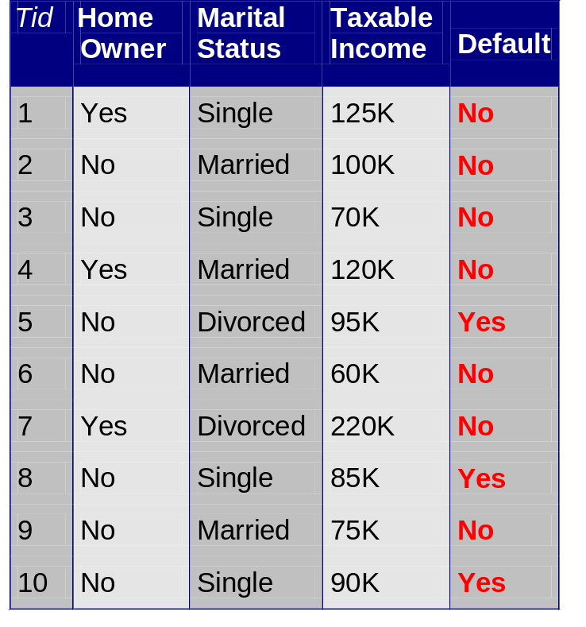
Example of a Decision Tree
categorical
categorical
continuous
class
Splitting Attributes
HO
Yes
No
NO
MarSt
Single, Divorced
Married
TaxInc
NO
< 80K
> 80K
NO
YES
Training Data
Model: Decision Tree

Slide 66
Another Example of Decision Tree
categorical
categorical
continuous
class
MarSt
Single, Divorced
Married
NO
HO
Yes
No
NO
TaxInc
< 80K
> 80K
NO
YES
There could be more than one tree that fits the same data!

Slide 67
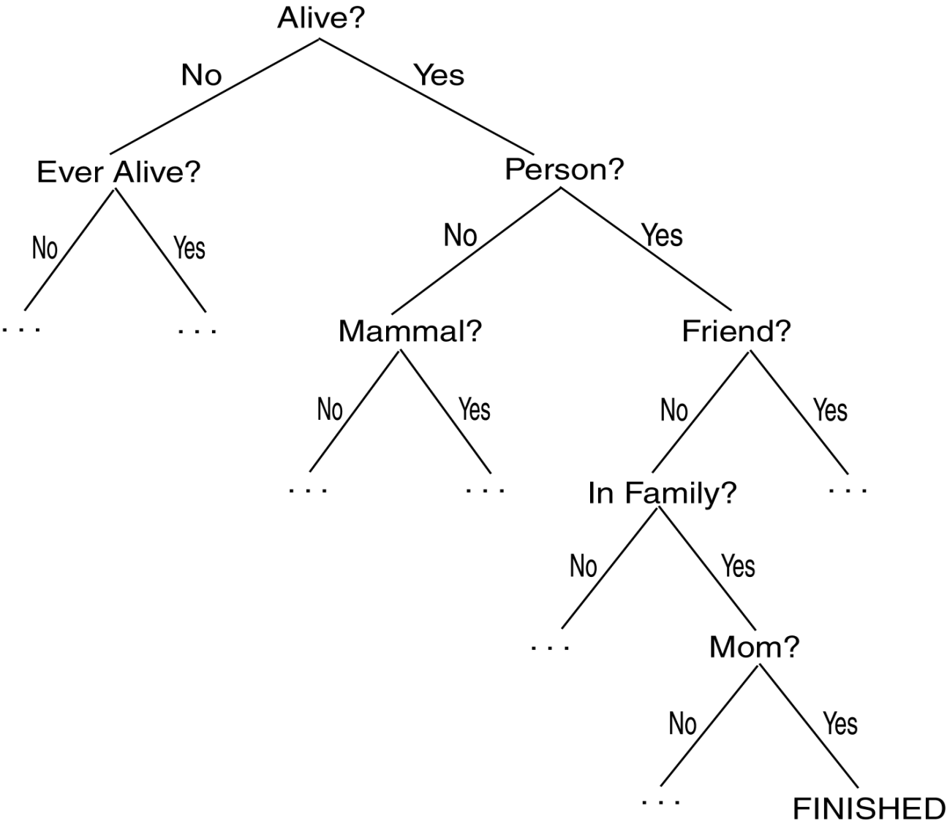
Twenty Questions Game

Slide 68
Decision Trees
Decision Tree (DT):
  Tree where the root and each internal node is labeled with a question.
  The arcs represent each possible answer to the associated question.
  Each leaf node represents a prediction of a solution to the problem.
Popular technique for classification; Leaf node indicates class to which the corresponding tuple belongs.

Slide 69
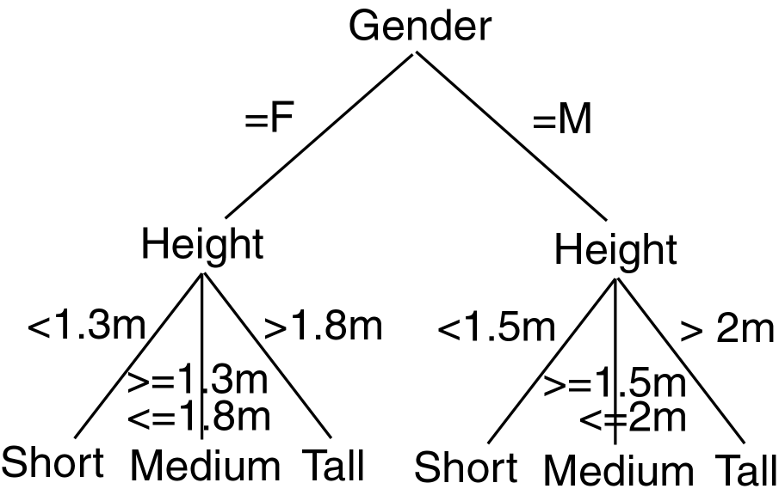
Decision Tree Example

Slide 70
Decision Trees
A Decision Tree Model is a computational model consisting of three parts:
  Decision Tree
  Algorithm to create the tree
  Algorithm that applies the tree to data
Creation of the tree is the most difficult part.
Processing is basically a search similar to that in a binary search tree (although DT may not be binary).

Slide 71
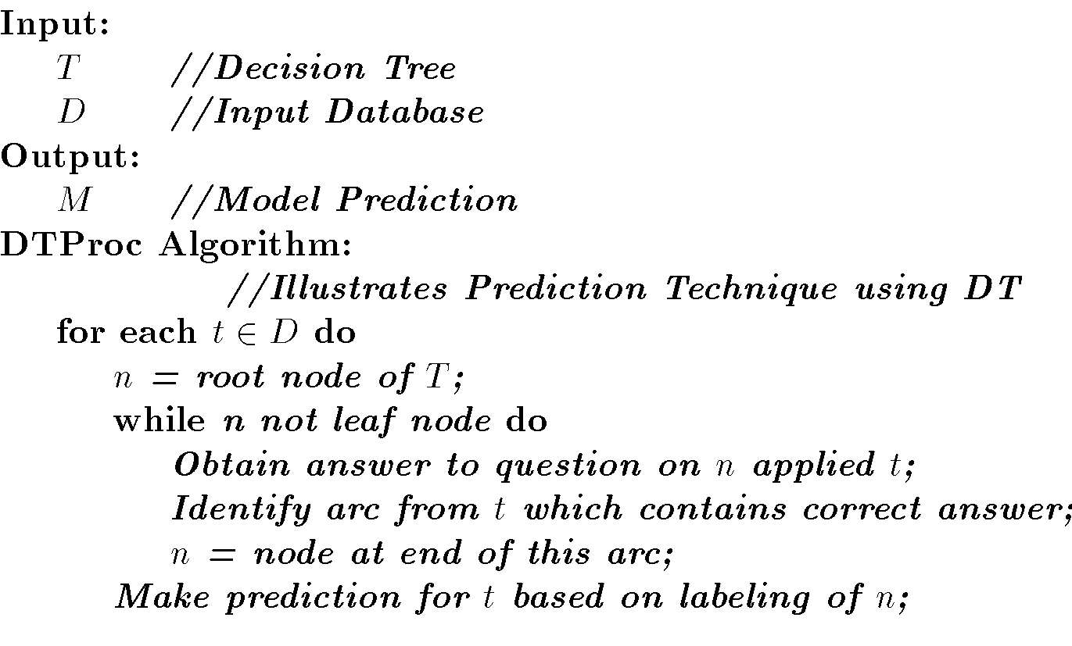
Decision Tree Algorithm

Slide 72
DT Advantages/Disadvantages
Advantages:
  Easy to understand.
  Easy to generate rules
Disadvantages:
  May suffer from overfitting.
  Classifies by rectangular partitioning.
  Does not easily handle nonnumeric data.
  Can be quite large – pruning is necessary.

Slide 73
Clustering

Slide 74
Clustering Definition
Given a set of data points, each having a set of attributes, and a similarity measure among them, find clusters such that
  Data points in one cluster are more similar to one another.
  Data points in separate clusters are less similar to one another.
Similarity Measures:
  Euclidean Distance if attributes are continuous.
  Other Problem-specific Measures.

Slide 75
Illustrating Clustering
Euclidean Distance Based Clustering in 3-D space.
Intracluster distances
are minimized
Intercluster distances
are maximized

Slide 76
Clustering: Application 1
Market Segmentation:
  Goal: subdivide a market into distinct subsets of customers where any subset may conceivably be selected as a market target to be reached with a distinct marketing mix.
  Approach:
    Collect different attributes of customers based on their geographical and lifestyle related information.
    Find clusters of similar customers.
    Measure the clustering quality by observing buying patterns of customers in same cluster vs. those from different clusters.

Slide 77
Clustering: Application 2
Document Clustering:
  Goal: To find groups of documents that are similar to each other based on the important terms appearing in them.
  Approach: To identify frequently occurring terms in each document. Form a similarity measure based on the frequencies of different terms. Use it to cluster.
  Gain: Information Retrieval can utilize the clusters to relate a new document or search term to clustered documents.

Slide 78
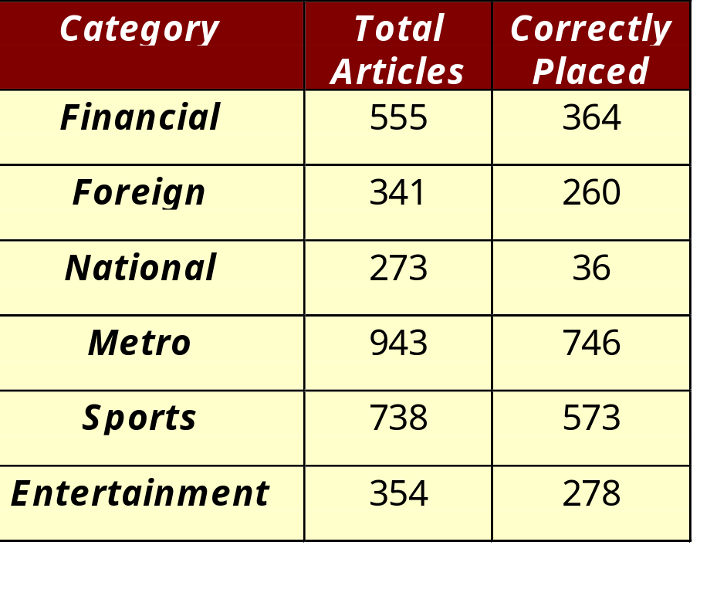
Illustrating Document Clustering
Clustering Points: 3204 Articles of Los Angeles Times.
Similarity Measure: How many words are common in these documents (after some word filtering).

Slide 79

Association Rule Discovery: Definition
Given a set of records each of which contain some number of items from a given collection;
  Produce dependency rules which will predict occurrence of an item based on occurrences of other items.
Rules Discovered:
{Milk} --> {Coke}
{Diaper, Milk} --> {Beer}

Slide 80
Association Rule Discovery: Application 1
Marketing and Sales Promotion:
  Let the rule discovered be
  {Bagels, … } --> {Potato Chips}
  Potato Chips as consequent => Can be used to determine what should be done to boost its sales.
  Bagels in the antecedent => Can be used to see which products would be affected if the store discontinues selling bagels.
  Bagels in antecedent and Potato chips in consequent => Can be used to see what products should be sold with Bagels to promote sale of Potato chips!

Slide 81
Association Rule Discovery: Application 2
Supermarket shelf management.
  Goal: To identify items that are bought together by sufficiently many customers.
  Approach: Process the point-of-sale data collected with barcode scanners to find dependencies among items.
  A classic rule --
    If a customer buys diaper and milk, then he is very likely to buy beer:

Slide 82
Clustering
Partitions data set into clusters, and models it by one representative from each cluster
Can be very effective if data is clustered but not if data is “smeared”
There are many choices of clustering definitions and clustering algorithms, more later!

Slide 83
Sampling
Allow a mining algorithm to run in complexity that is potentially sub-linear to the size of the data
Choose a representative subset of the data
  Simple random sampling may have very poor performance in the presence of skew
Develop adaptive sampling methods
  Stratified sampling:
    Approximate the percentage of each class (or subpopulation of interest) in the overall database
    Used in conjunction with skewed data
Sampling may not reduce database I/Os (page at a time).

Slide 84
Sampling
SRSWOR
(simple random
sample without
replacement)
SRSWR
Raw Data

Slide 85
Sampling
Raw Data
Cluster/Stratified Sample
The number of samples drawn from each cluster/stratum is analogous to its size
Thus, the samples represent better the data and outliers are avoided

Slide 86
Data Mining in Practice

Slide 87
Application Areas
Industry
Application
Finance
Credit Card Analysis
Insurance
Claims, Fraud Analysis
Telecommunication
Call record analysis
Transport
Logistics management
Consumer goods
promotion analysis
Data Service providers
Value added data
Utilities
Power usage analysis

Slide 88
Why Now?
Data is being produced
Data is being warehoused
The computing power is available
The computing power is affordable
The competitive pressures are strong
Commercial products are available

Slide 89

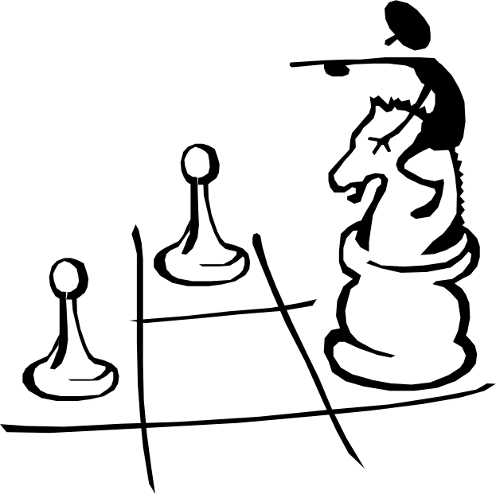
Data Mining works with Warehouse Data
Data Warehousing provides the Enterprise with a memory
Data Mining provides the Enterprise with intelligence

Slide 90
Data Mining in Use
The US Government uses Data Mining to track fraud
A Supermarket becomes an information broker
Basketball teams use it to track game strategy
Cross Selling
Target Marketing
Holding on to Good Customers
Weeding out Bad Customers

Slide 91
Thanks

